Slide 1
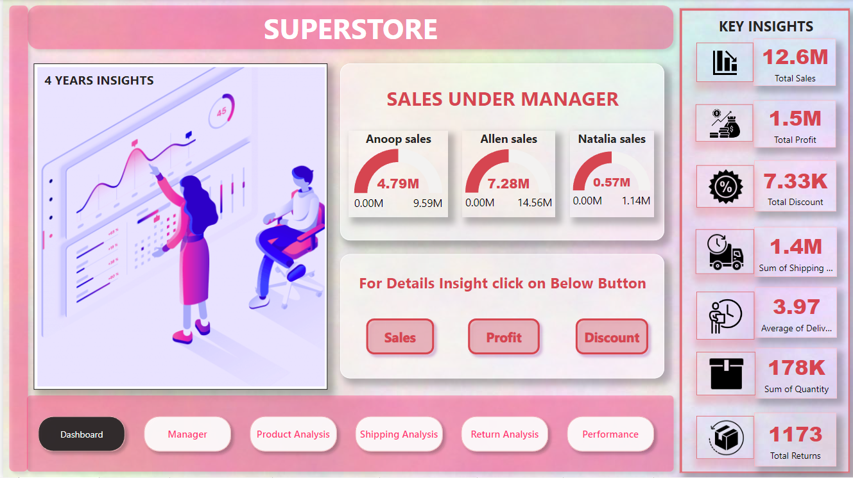
Building a Sales Dashboard in Power BI for Superstore Dataset
In this presentation, we will explore the process of building an informative sales dashboard using the Superstore dataset, and how this can support data-driven decision-making.
DataAsh21

Slide 2
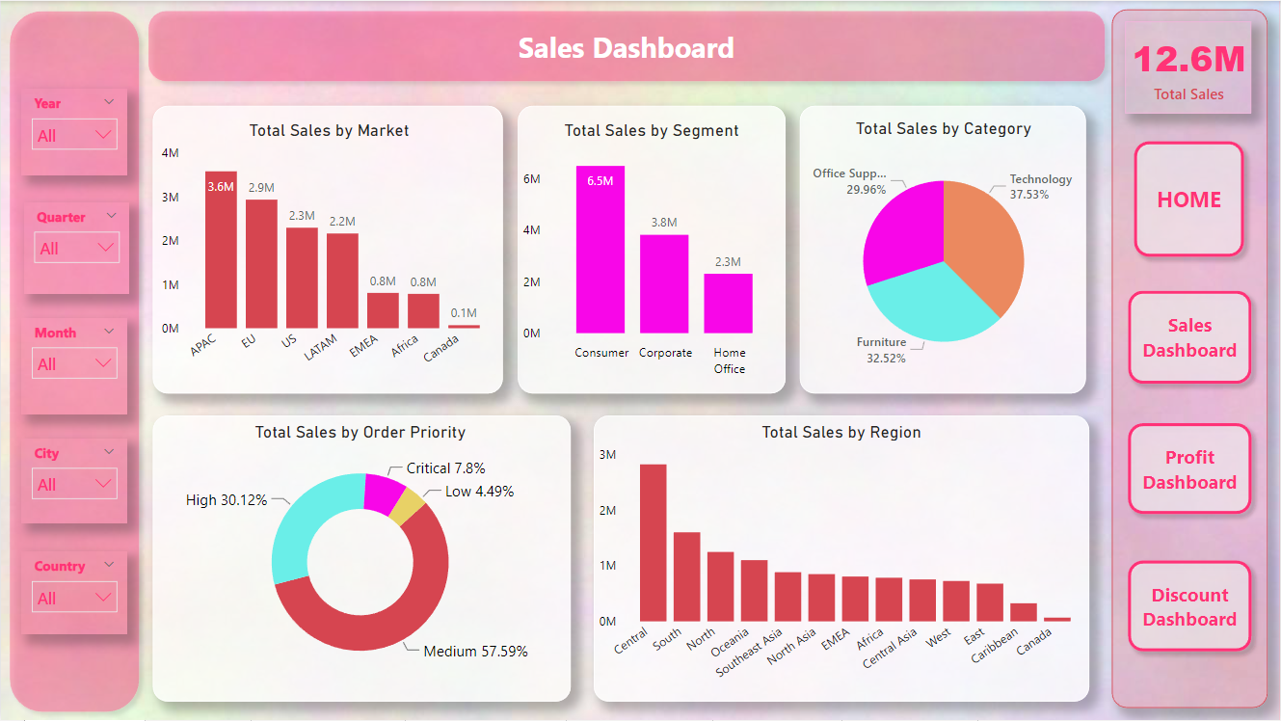
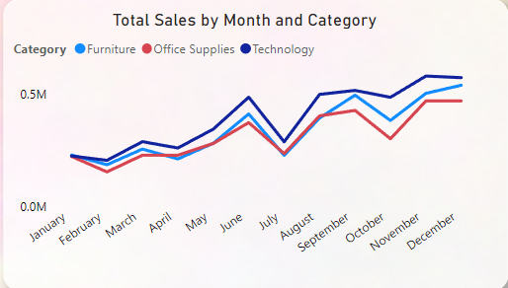
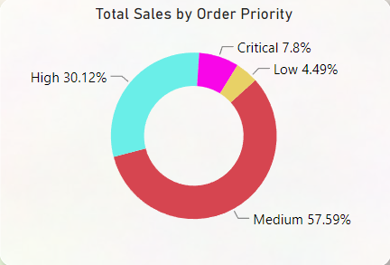
Superstore Dataset
Introduction to the dataset
Key features and variables
Data visualization in sales
The Superstore dataset is a comprehensive and realistic dataset that represents the sales data of a fictional retail company. It contains information about various aspects of the company's operations, including sales, customers, products, and regions.
The dataset consists of variables such as sales, profits, customer segments, products, and geographic regions. We can use this data to identify trends and patterns that inform important business decisions.
Effective data visualization techniques allow us to extract insights from complex data and present them in a user-friendly format that is easy to understand. This is particularly important for sales analysis, where we need to quickly identify trends to remain competitive.

Slide 3
Designing the Dashboard
Key considerations
Visual elements and charts used
The purpose of the dashboard is to convey important sales KPIs in a clear and concise manner.
Various visualizations are used, including tables, line charts, bar charts, and maps.
The dashboard should be easy to navigate and update with new information.
Filters and slicers are used to enable users to interact with the dashboard and customize their view according to their requirements.
The dashboard should provide a high-level overview of sales performance, while also providing detailed insights at more granular levels.
Drill-down features enable users to access underlying transactional level data to gain a deeper understanding of what is driving sales performance.

Slide 4
Building the Dashboard in Power BI
Step 4: Publish and share the dashboard
Step 2: Design visual elements
The final step is to publish the dashboard to Power BI service, configure sharing and access permissions, and schedule data refreshes as needed. Users can then view and interact with the dashboard in real-time.
Identify the key metrics and KPIs, and start designing charts, tables, and other visualizations that will be used on the dashboard.
1
2
3
4
Step 1: Data preparation and cleaning
Step 3: Build the dashboard
This involves extracting data from multiple sources, cleaning and transforming data, and organizing it in a format that can be used for reporting.
Using drag-and-drop features, assemble the visualizations onto a dashboard canvas in Power BI. Add supporting text and graphics, and fine-tune the layout to enhance usability.

Slide 5
Interpreting the Dashboard
Insights gained from the dashboard
How to use insights to inform business decisions
Benefits of using a sales dashboard
Gain a broader understanding of how different factors impact sales performance, including geographic regions, customer segments, and product categories.
Use the insights gained from the dashboard to optimize pricing strategies, product lines, and marketing campaigns for increased sales and profits.
A sales dashboard keeps your finger on the pulse of your business and helps you respond quickly to changing market conditions.

Slide 6
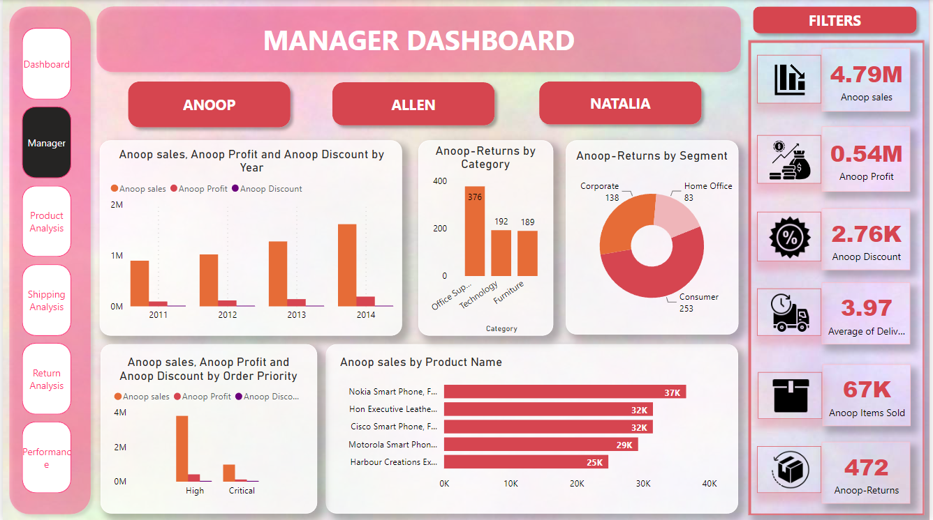
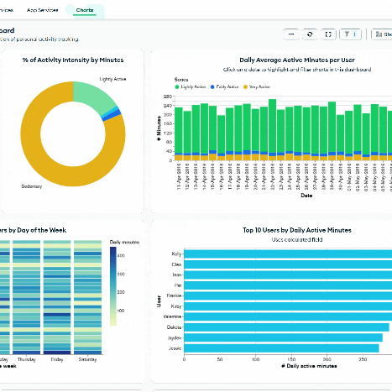
Conclusion
Recap of key points
Future improvements and enhancements to the dashboard
We learned how to build a sales dashboard that enables data-driven decision making and provides real-time insights into sales performance.
Continue to refine the dashboard with new data sources, visualizations, and interactive features that make it more intuitive to use.

